Slide 1

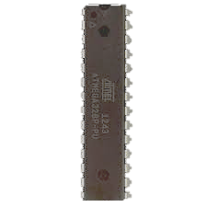

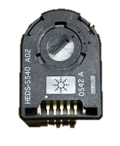
Brief illustration of operation
AVR Microcontroller
Processes Encoder & Timer; sends position and time data whenever they trigger
USART Serial Data [Position (2 Bytes)][Time (2 bytes)]\r\n
PC processes serial data, charting it and preparing for export
A and B pin CHANGE Interrupt Triggered

